Slide 1
INVESTMENT CASE STUDY
SUBMISSION
Santhosh Kumar

Slide 2
Spark Funds Investment Case Study
Spark Funds wants to make investments in a few companies.
Spark Funds wants to understand the global trends in investments so that she can take the investment decisions effectively.
Spark Funds has two minor constraints for investments:
It wants to invest between 5 to 15 million USD per round of investment
It wants to invest only in English-speaking countries because of the ease of communication with the companies it would invest in

Slide 3
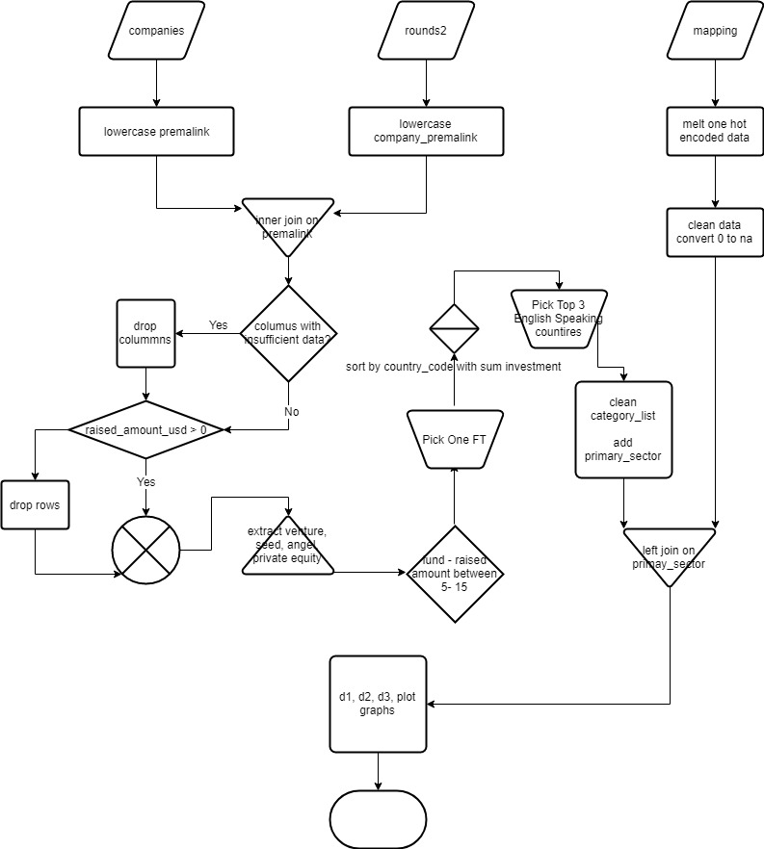
Flow chart

Slide 4
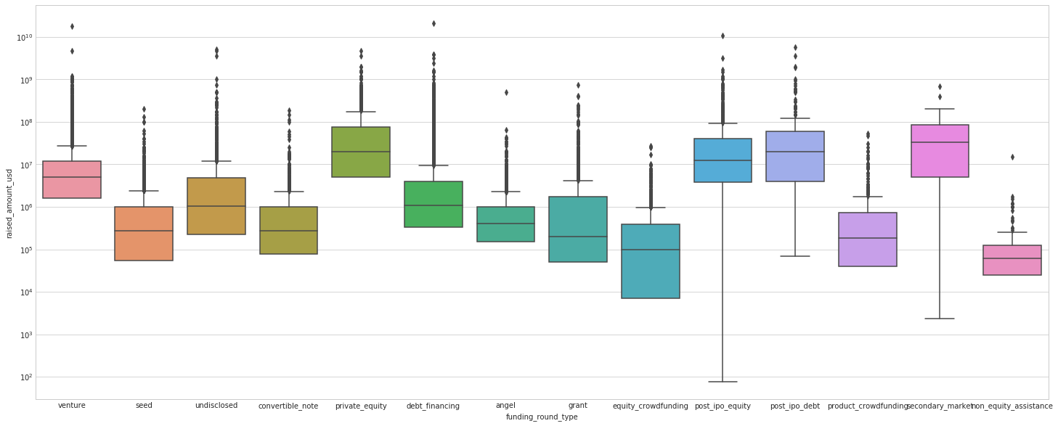
Investment across all Fund type

Slide 5
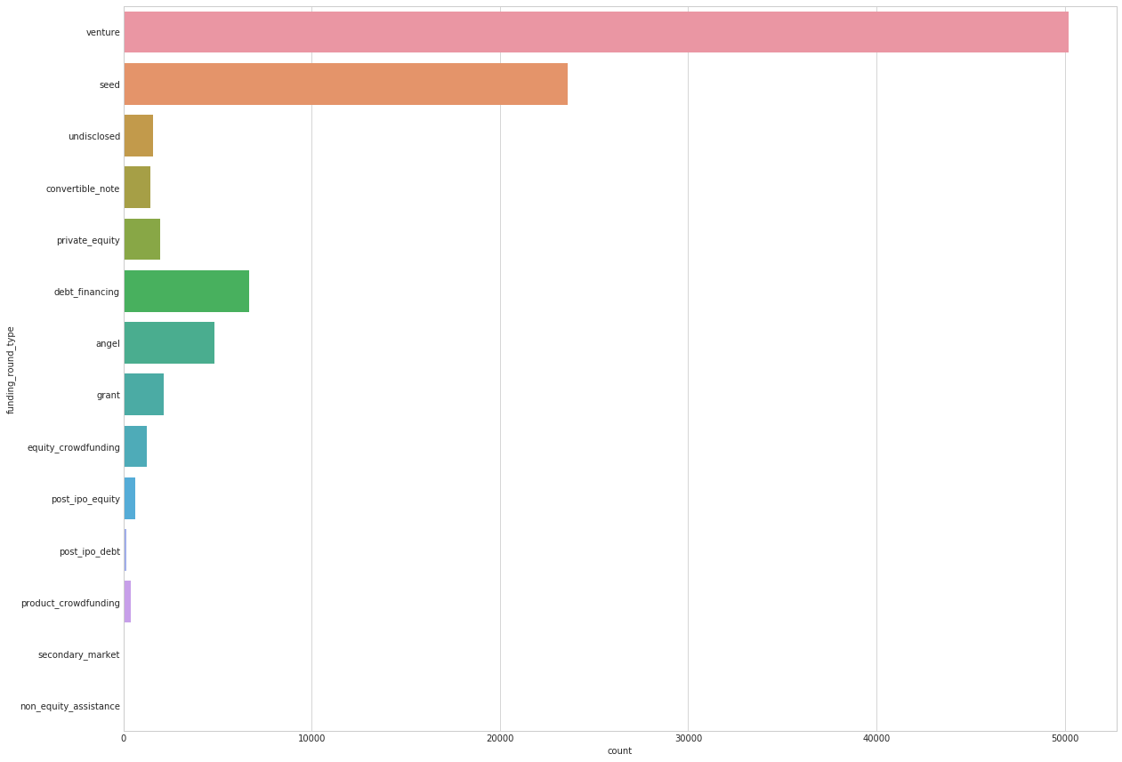
Investment trend shows huge number of players investing in Venture funding

Slide 6
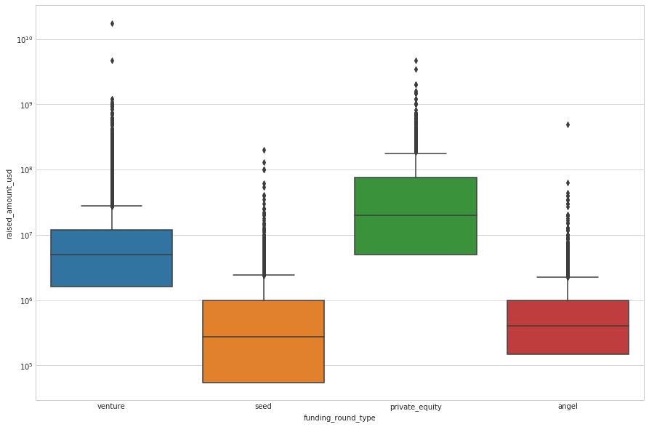
Boxplot of a raised USD amount across various 4 targeted categories

Slide 7
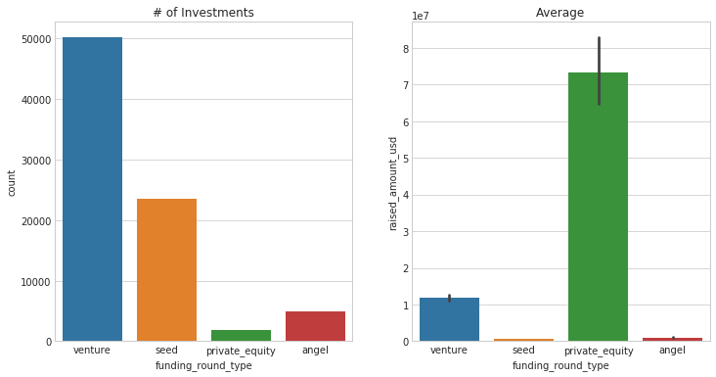
Fraction of total investments (globally) in venture, seed, and private equity, and the average amount of investment in each funding type
Venture has lot of investments and it also falls into the 5-15 million budget

Slide 8
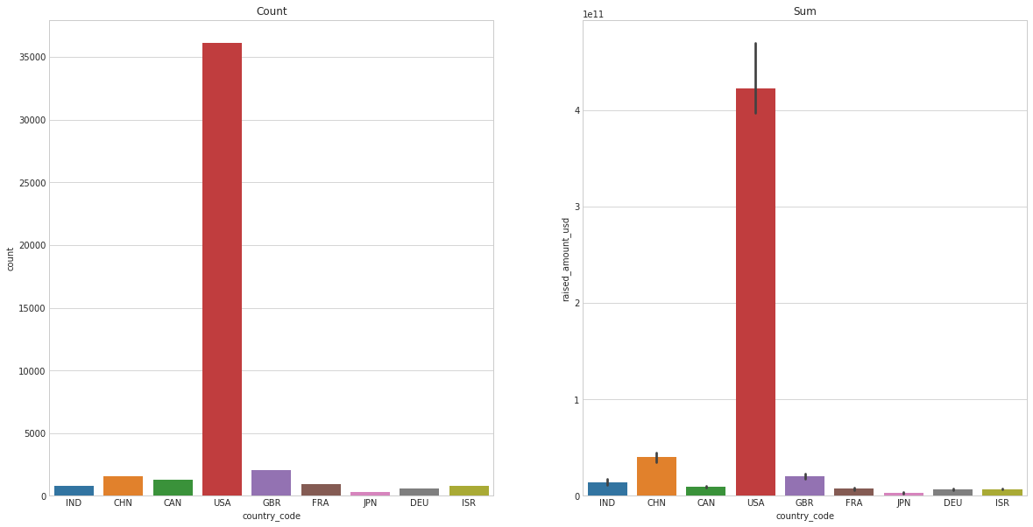
Top 9 countries against the total amount of investments of funding type “Venture”

Slide 9
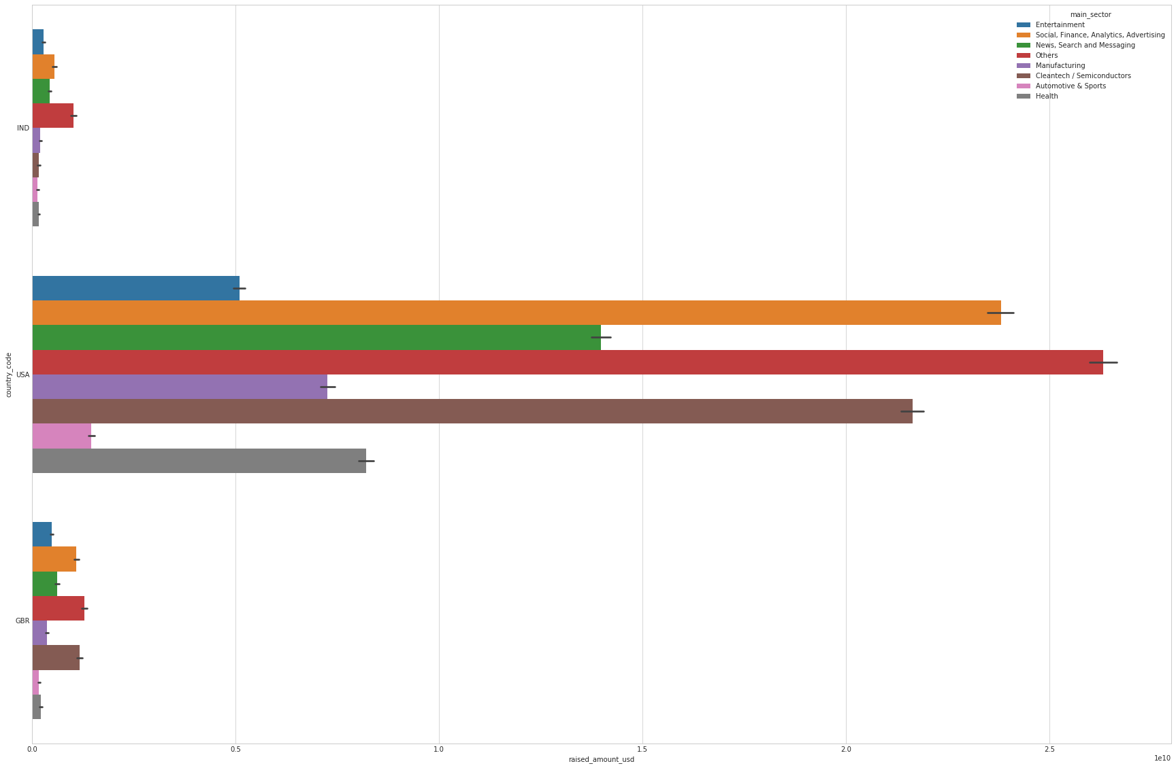
Investments in the top 3 sectors of the top 3 countries
<Results>

Slide 10
Conclusions
Based on the data it is clear that USA is the prime place to make investment, going by the number and volume of investments, 50% of the amount can be invested in the top 2 companies on the top 2 sectors shared equally among all 4 companies
Virtustream
Capella
Shotspotter
Demandbase
Next set of investment 25% each can be made at the top company of the top 2 sector in GBR and India respectively
electric-cloud
celltick-technologies
manthan-systems
firstcry-com
Which makes an even share of 12.5% across all the identified 8 companies.
Average total investment across the 8 identified companies as per the data is around 40 million with median between 5-15 million

